Slide 1
Give Your AI a Job

Slide 2
Prerequisites
Everything you need to get started

Slide 3
What to install
You will also need some accounts
Windsurf:
https://windsurf.com/download
choco install windsurf
winget install --exact --id Codeium.Windsurf
brew install --cask windsurf
Git:
https://git-scm.com/install/windows
choco install git
winget install --id Git.Git -e --source winget
brew install git
Github Account:
https://github.com/signup
Use Improving email if you don’t have one
Post username in chat
Windsurf Account:
https://windsurf.com/profile
Log in with Devin for Enterprise (Beta)
Notes:
Paste from instructions.md

Slide 4
Objective of the course
What we hope you will learn
Introduction to IDEs
Git via Windsurf
Markdown Fundamentals
LLM Integration in Windsurf
Q&A – Exploration

Slide 5
What is an IDE?
Integrated Development Environment

Slide 6
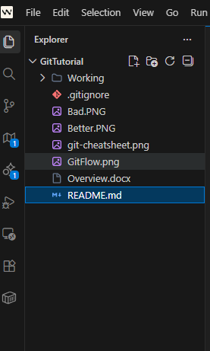
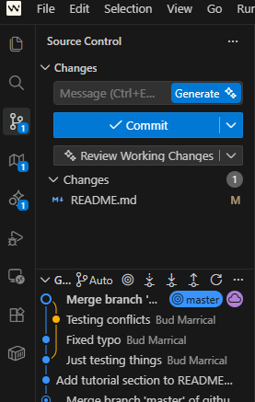
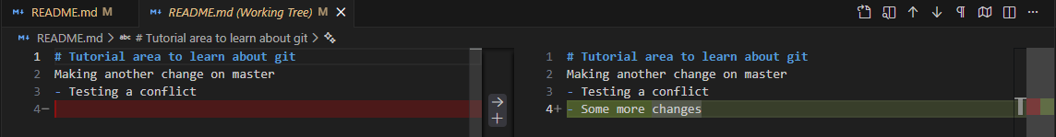
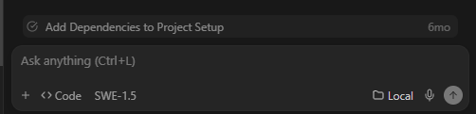
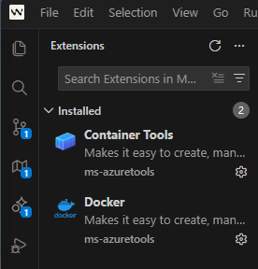
Windsurf IDE
It’s the tools!

Slide 7
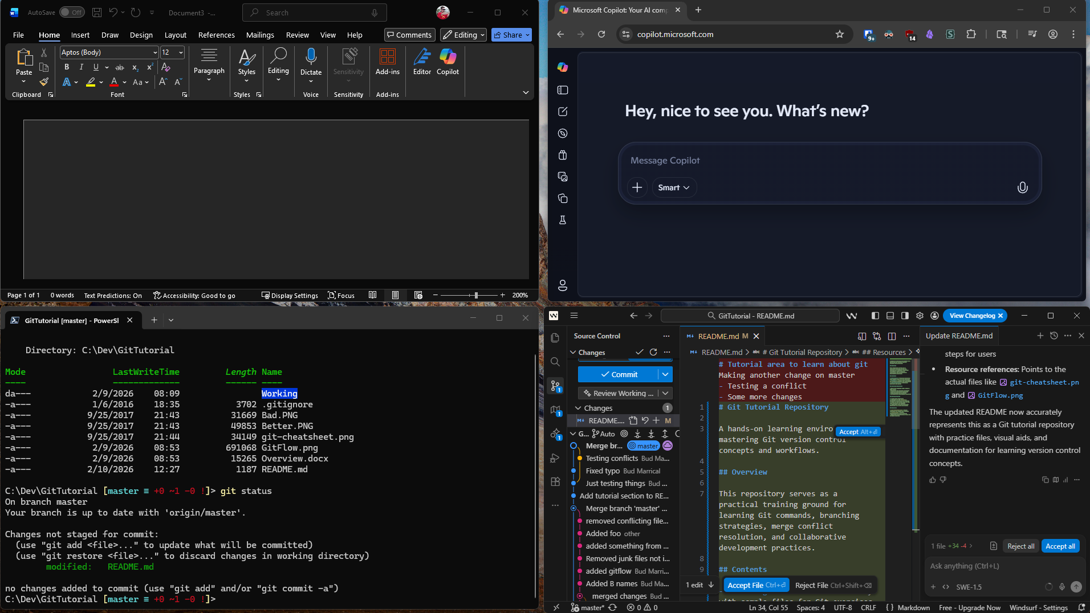
But you’re not a dev

Slide 8

Open Windsurf
Quick familiarization and plugins

Slide 9
Git
Saving your work

Slide 10
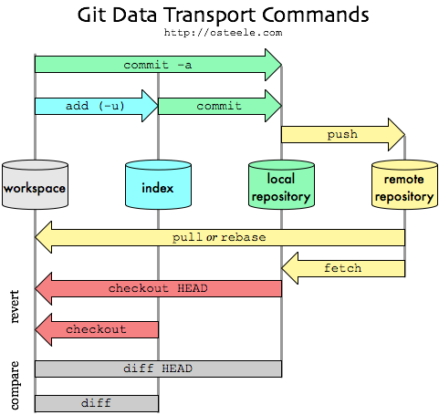
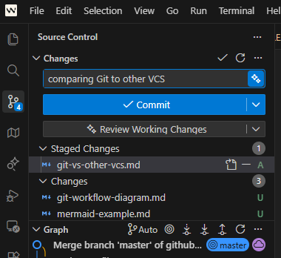
Git Cheatsheet

Slide 11
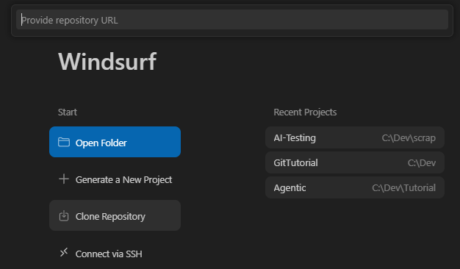
Pulling a repository
Notes:
Source: https://github.com/Bud-Improving/AI-Testing/

Slide 12
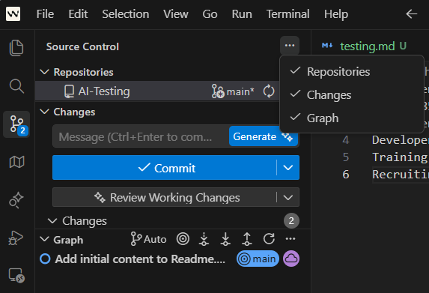
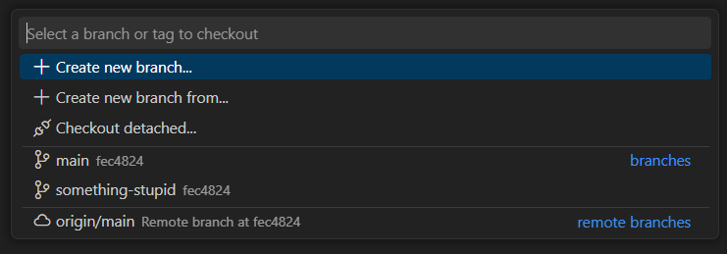

Creating a branch

Slide 13
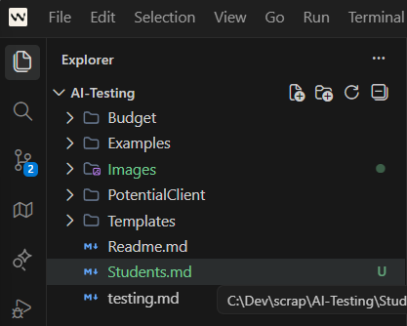
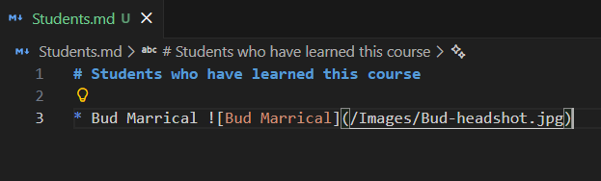
Making a change

Slide 14
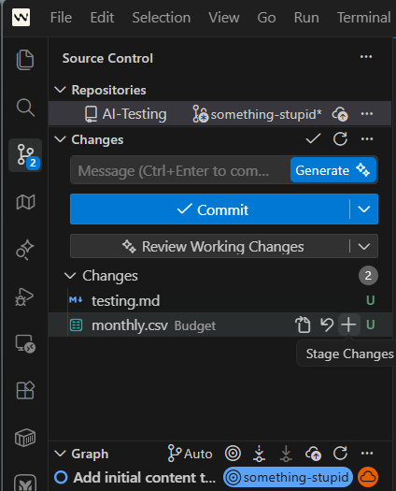
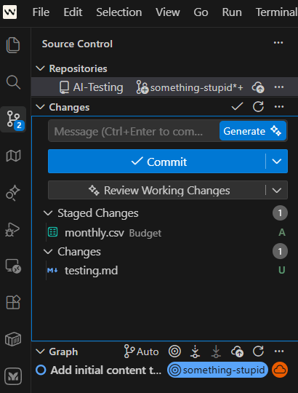
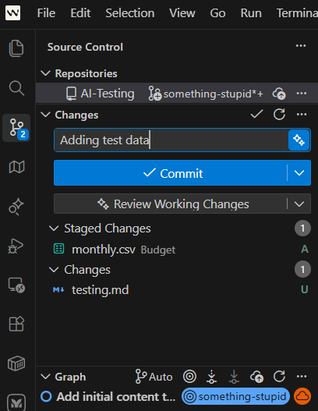
Commits
Notes:
When errors happen, paste from Instructions.md

Slide 15
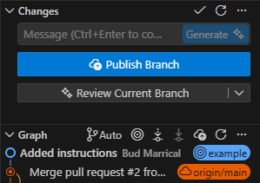
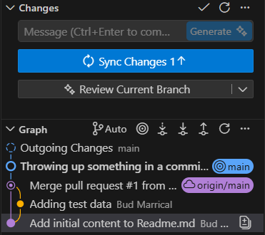
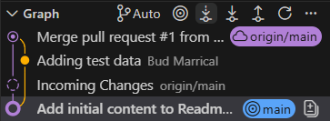
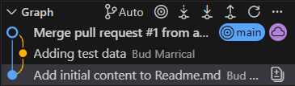
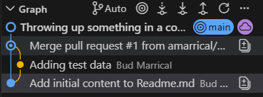
Keeping in Sync
Push, Fetch, Pull
Notes:
There may be popups / permission errors when pushing new branch

Slide 16
Markdown

Slide 17
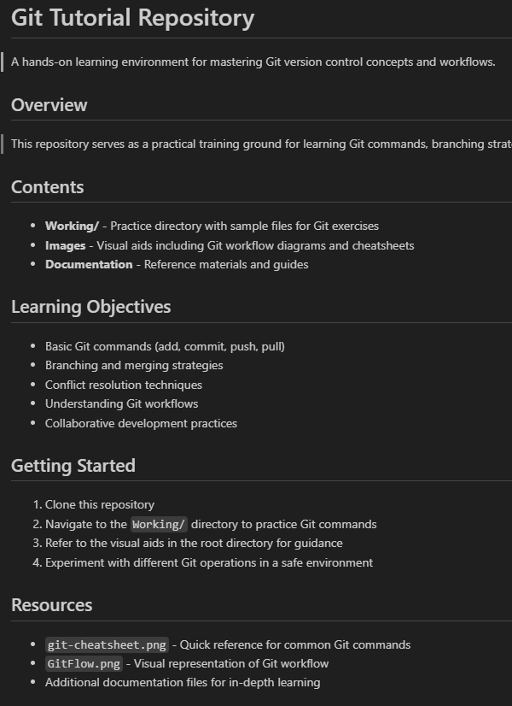
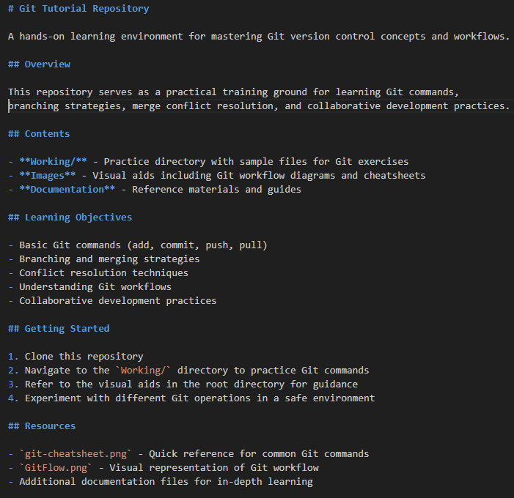
Markdown vs Text
# Headings
1. Ordered Lists
- Unordered Lists
**Bold**
_italics_
`Highlighted`
``` block ```
> Quoted

Slide 18
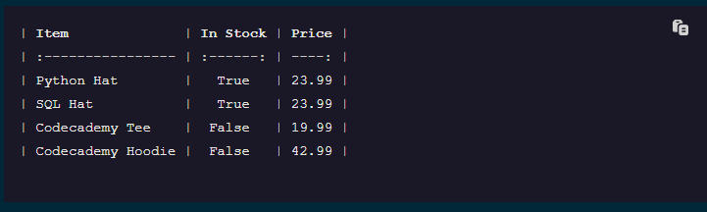
Advanced Markdown
Links: [text to display](https://www.example.com “hover text”)
Images: ![alt text](/path/to/image “hover text”)
Tables:

Slide 19
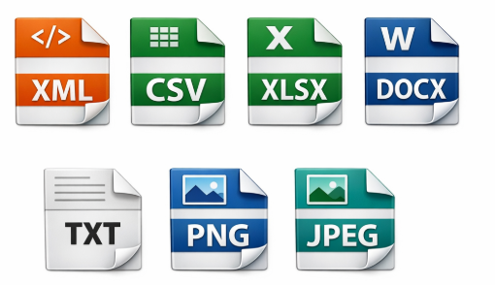
Other File formats
Mermaid and non-Markdown files

Slide 20
LLM Integration in Windsurf

Slide 21
Asking basic questions
Where is that LLM tool?
How to open Cascade Code
Choosing code/ask/plan
Choosing LLM
Context and starting a new session

Slide 22
Generating and editing markdown
Hands on time!
Ask your LLM to create some documentation
Accept/Reject results
Edit/enhance that documentation
Play with context

Slide 23
Diagrams
Creating those mermaid files

Slide 24
Q&A
What’s next?

